Slide 1
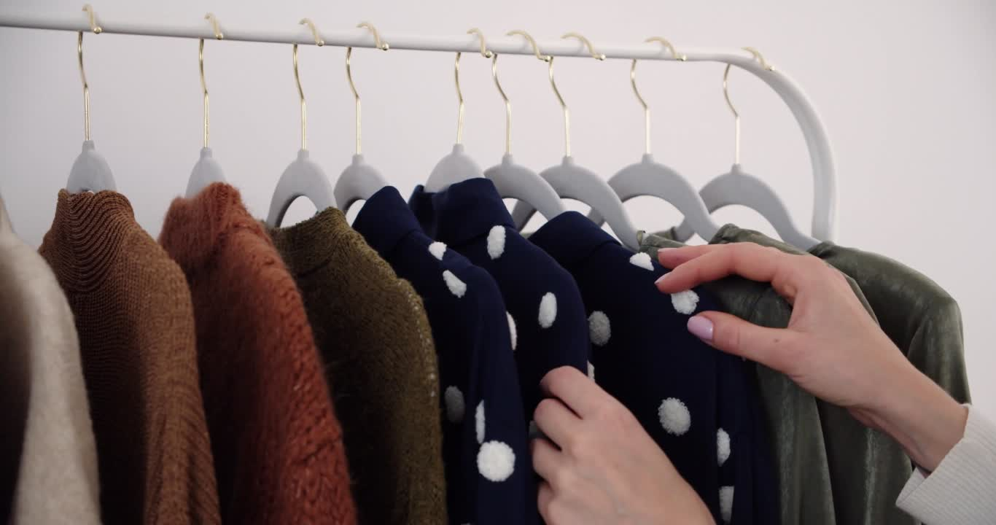

Fast Fashion
UNDERSTANDING BUSINESS DYNAMICS, CUSTOMER SENTIMENT, AND MARKET TRENDS :
A DATA-DRIVEN ANALYSIS
Team Members:
Arina Chen
Ming Chang
Jeffrey John Kennedy
Vishnu Kora
Rutuja Patel

Slide 2
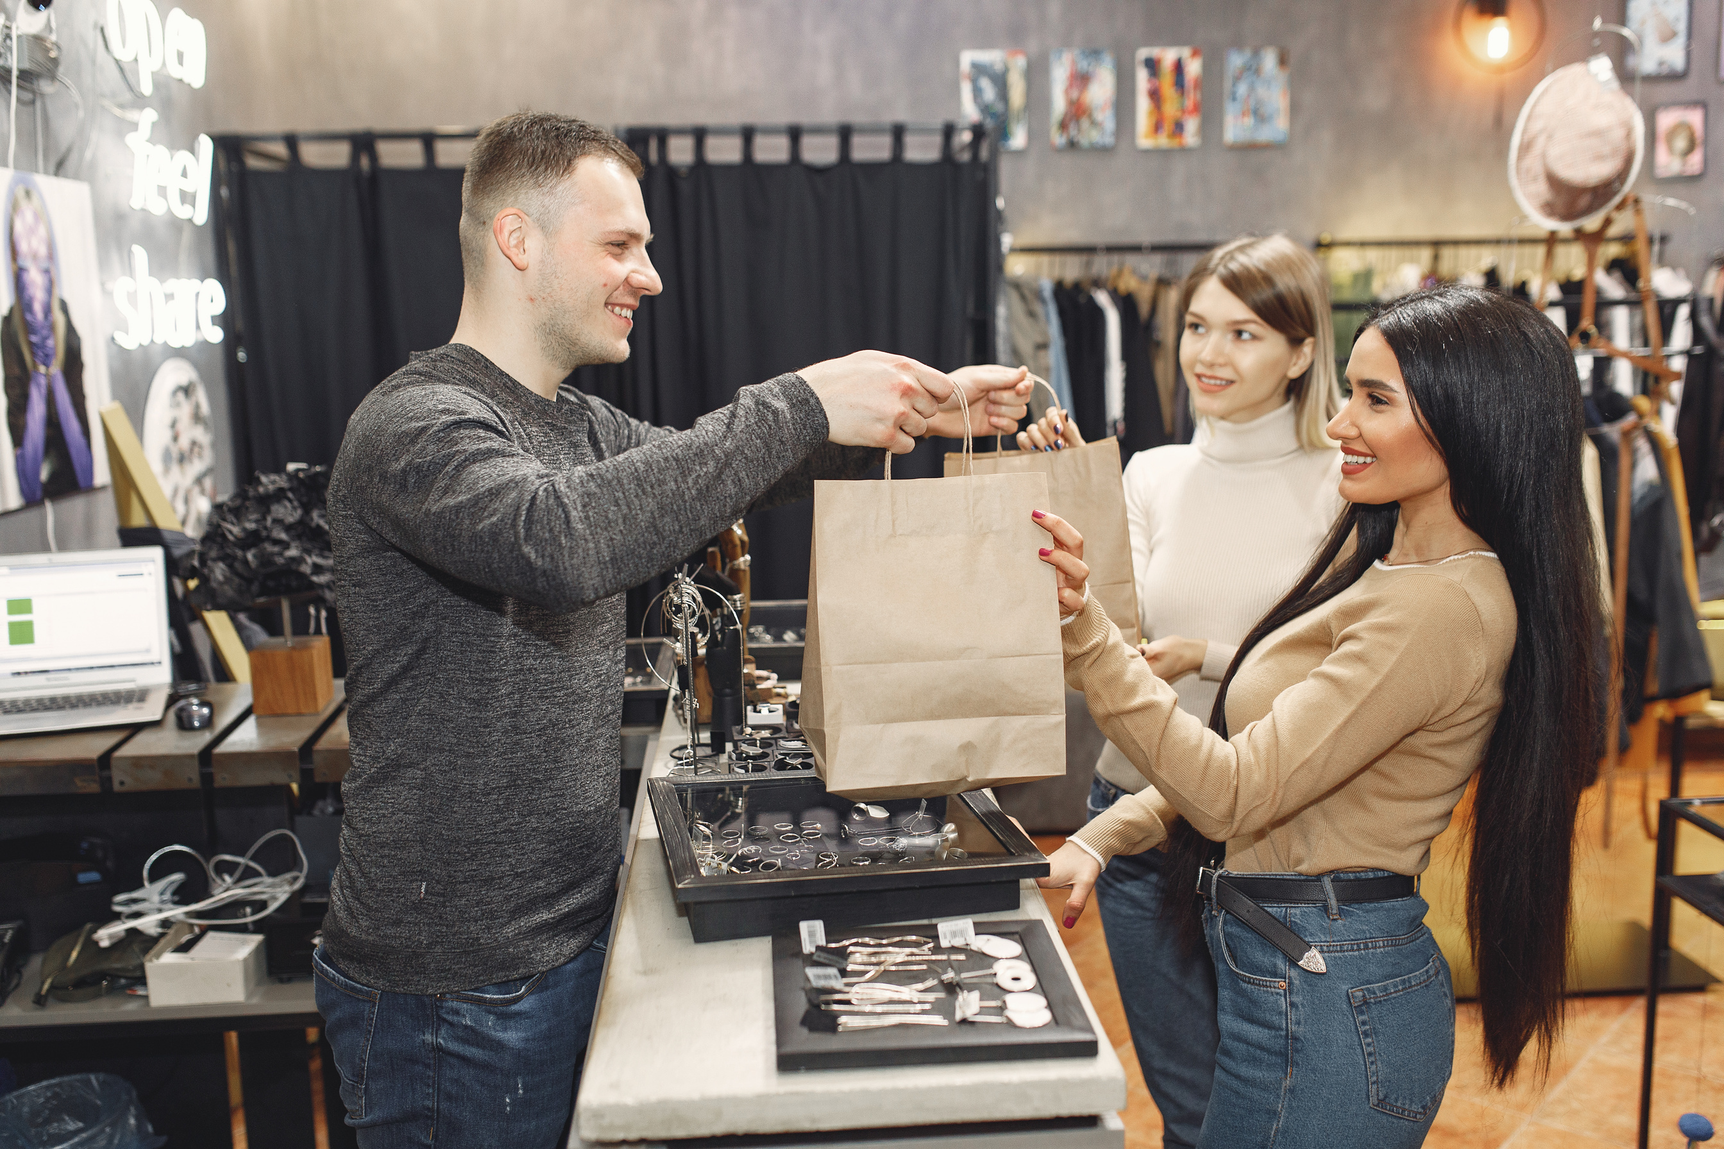
Analyzing Business Dynamics: Store Performance & Customer Engagement

Slide 3
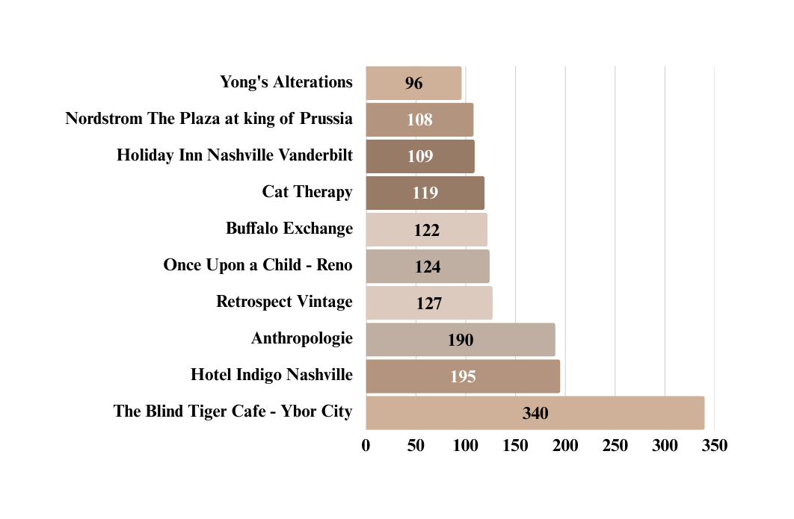
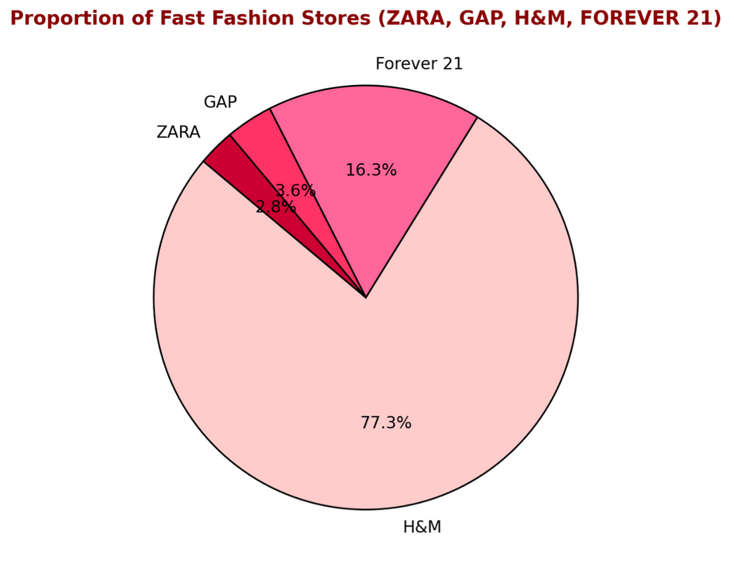
Fast Fashion vs Top Other Fasion Brand Store Count
Top other Fashion Brand by Store Count
Brand
No. of Stores
Notes:
Observations:
H&M dominates with 77.3% of stores, reflecting its global presence, affordability, and expansion strategy.
Forever 21 holds 16.3%, maintaining a strong market presence, especially among younger shoppers.
GAP (3.6%) and ZARA (2.8%) have a smaller footprint, likely due to selective store placement (GAP) and a flagship-focused model (ZARA).
The uneven distribution highlights H&M’s competitive edge in supply chain, pricing, and global reach, while others may prioritize niche markets or online retail.

Slide 4
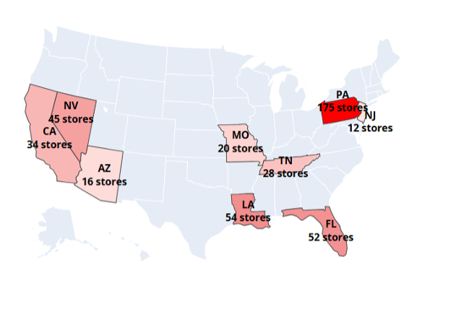
Fast Fashion store distribution in US
Pennsylvania is a Key Market – Fast fashion brands should invest in promotions, customer loyalty programs, and new store openings in PA.
Expansion Opportunities in NJ & AZ – Since these states have lower store counts, brands could explore untapped markets or strengthen online presence.
Target Shopping Hubs in FL & NV – These states are major tourist and retail destinations, making them ideal for flagship stores and aggressive marketing strategies.

Slide 5
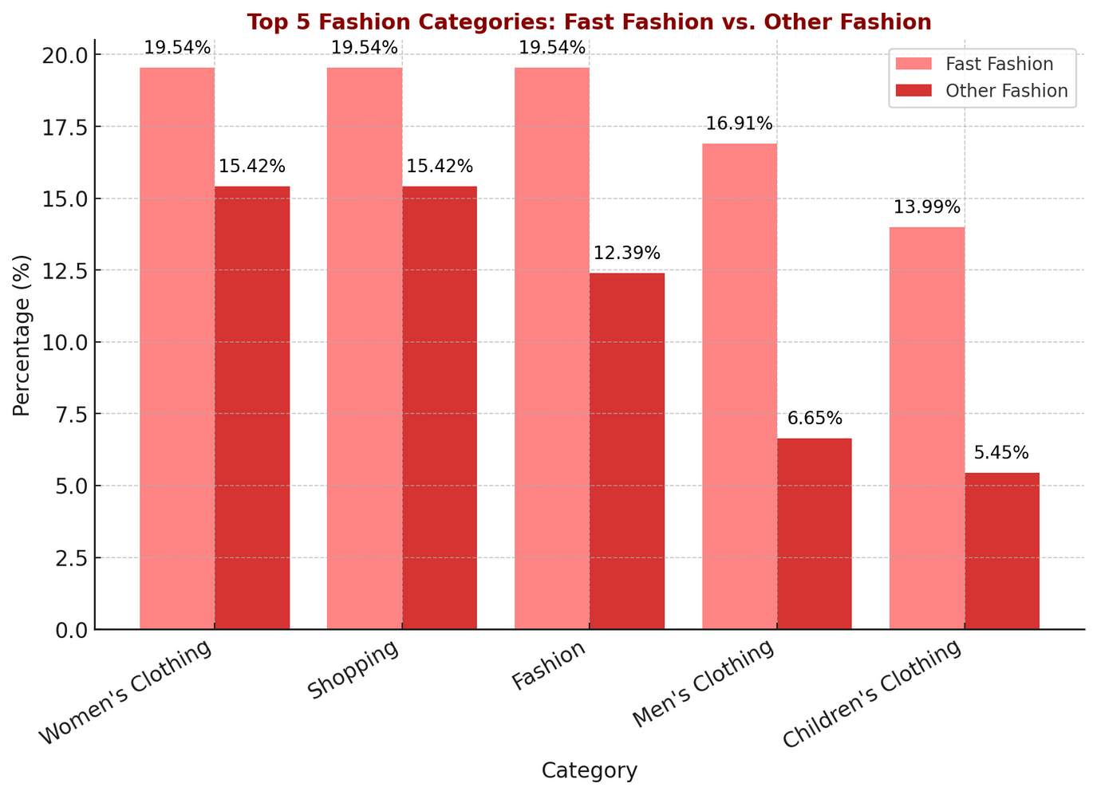
Common store category
Fast Fashion dominates in all categories, especially in Women’s Clothing, Shopping, and Fashion (each at 19.54%), indicating a strong focus on mainstream apparel.
Other Fashion has a more balanced distribution, with a higher presence in Men’s Clothing (6.65%) and Accessories (5.45%), showing a diversified market approach.
Children’s Clothing has a significant gap, with Fast Fashion (13.99%) outperforming Other Fashion (5.45%), suggesting greater accessibility and variety for kids’ apparel in fast fashion brands.

Slide 6
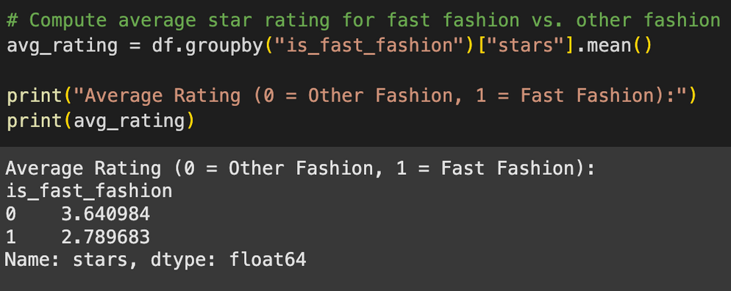
Average Customer Rating for Fast Fashion vs Other Fashion
Other fashion brands have a higher average rating (3.64⭐) compared to fast fashion brands (2.79⭐), indicating better customer satisfaction.
The lower rating for fast fashion suggests potential issues with product quality, customer service, or shopping experience.

Slide 7
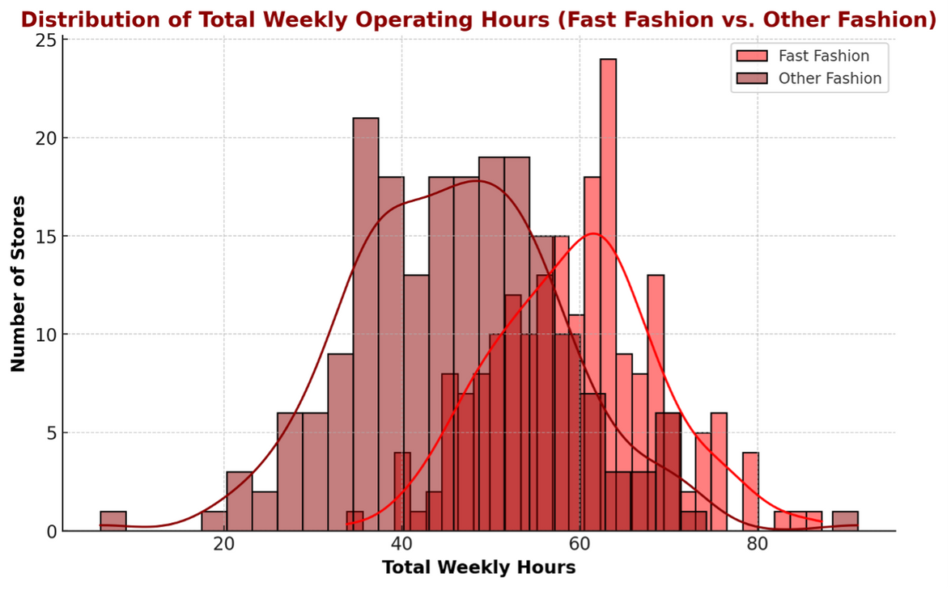
Weekly Operating Hours
Fast fashion stores stay open longer – Most fast fashion stores operate around 60-70 hours per week, while other fashion stores have more variation.
Other fashion stores have mixed schedules – Some open fewer hours, while others operate longer, creating a wider spread in the data.
The red lines show trends – The smooth curves (KDE lines) highlight the general pattern: fast fashion has a more consistent schedule, while other fashion stores vary more.

Slide 8
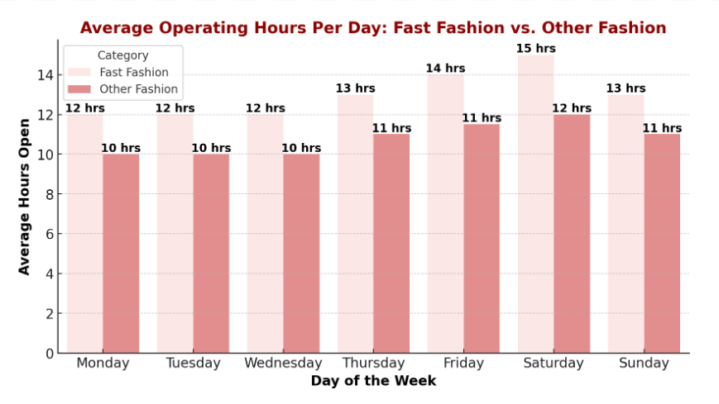

Slide 9

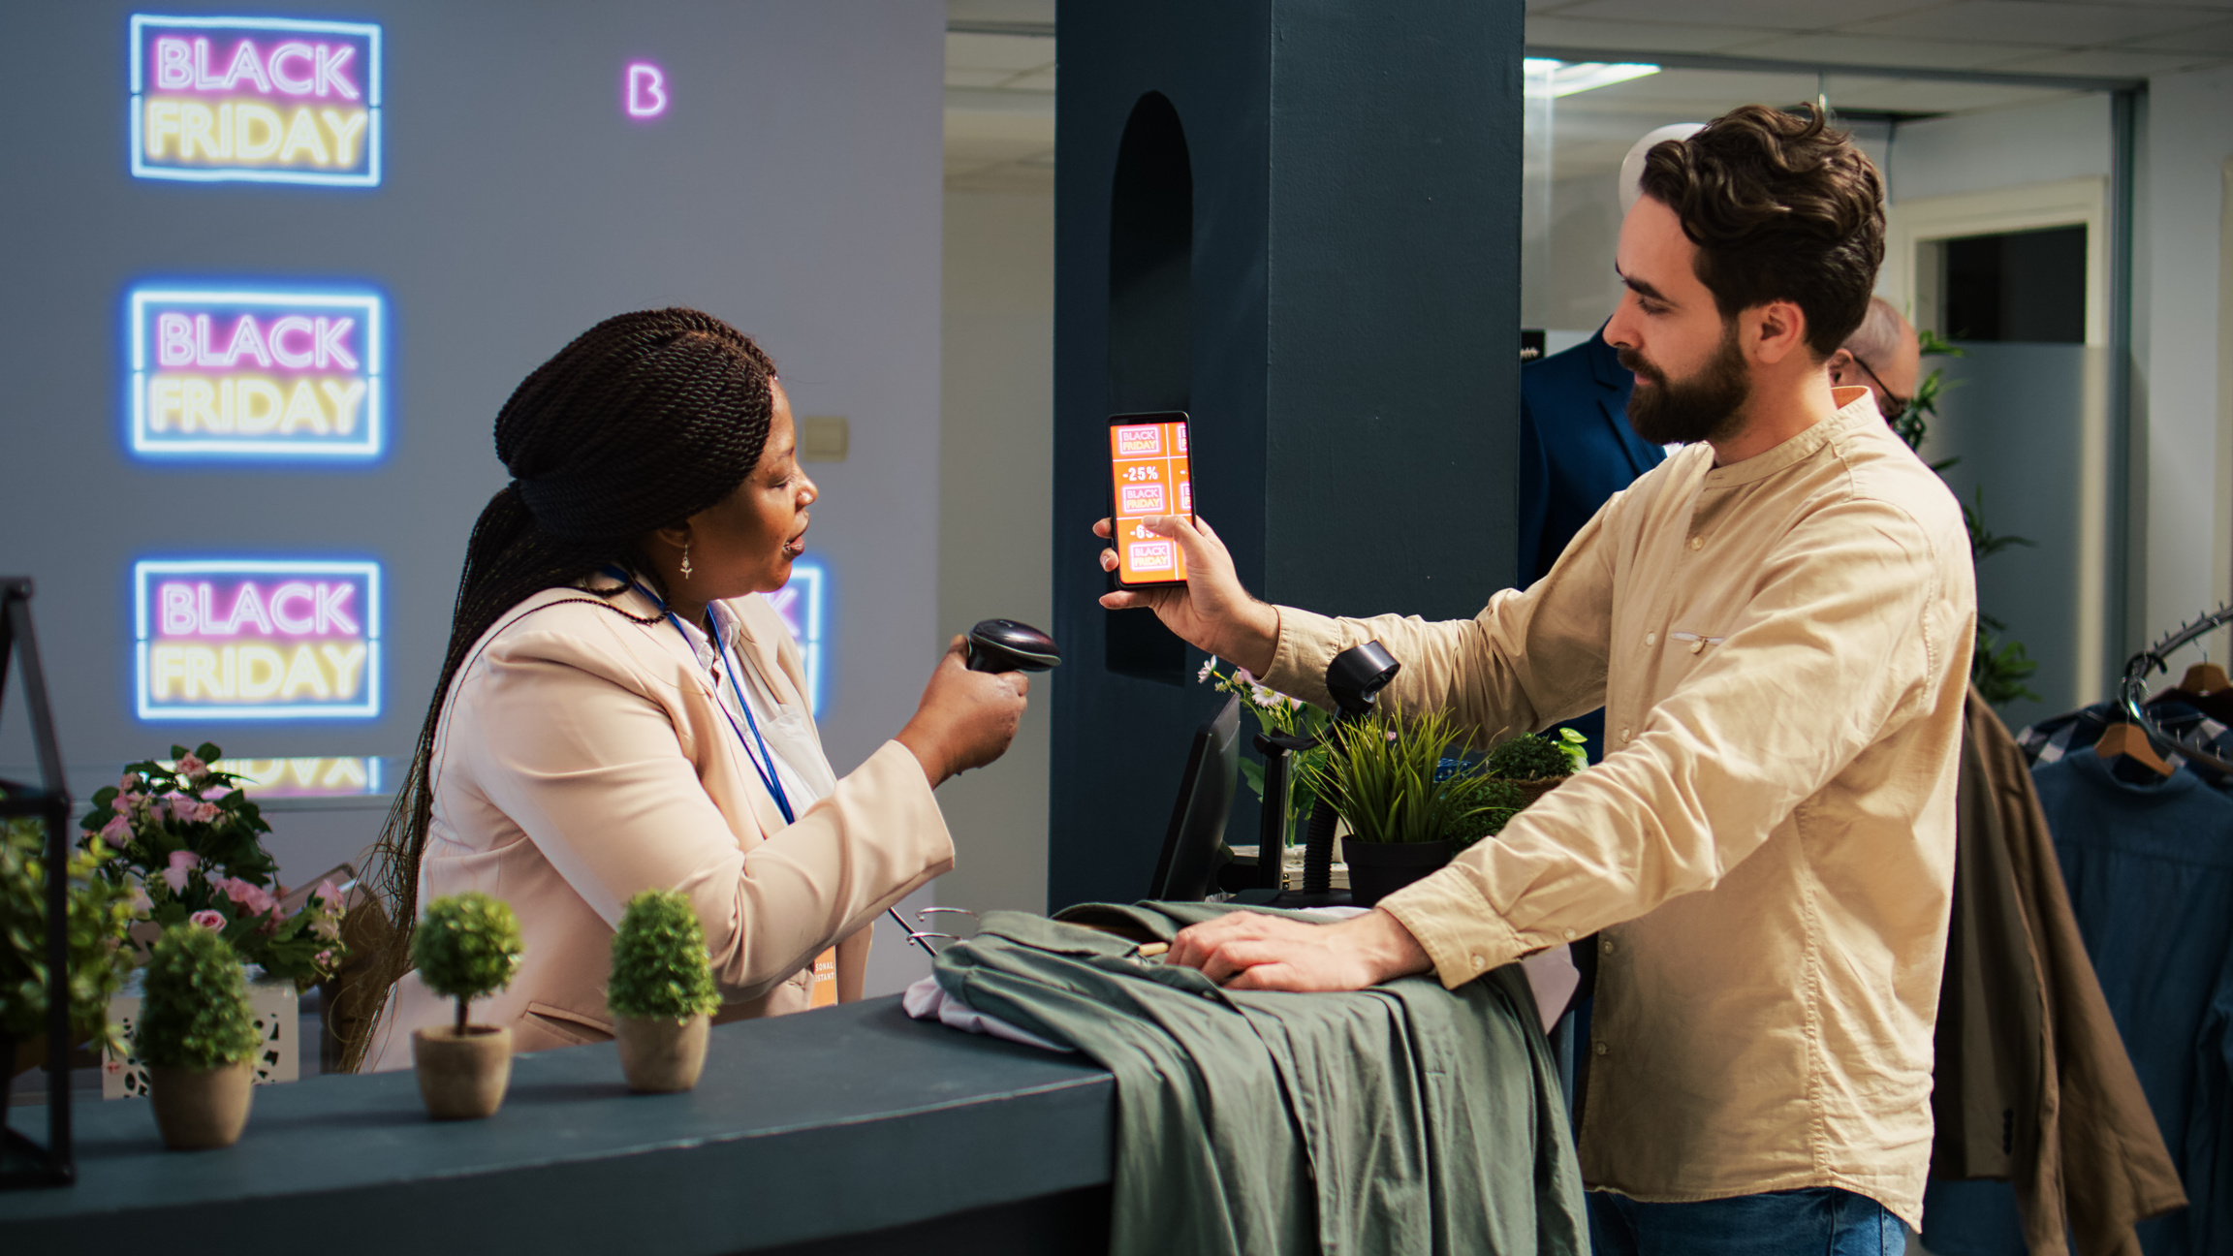
Customer Sentiment Analysis:
What Do Customers Think?

Slide 10
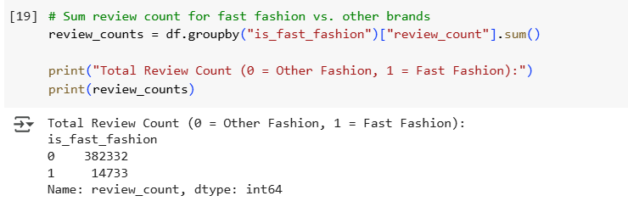
Review Count
The goal of this analysis is to compare the total number of reviews received by fast fashion brands versus other brands. By summing up the review counts for each category, we can assess consumer engagement and popularity.
Findings
From the dataset, the total number of reviews is distributed as follows:
Other Fashion Brands (is_fast_fashion = 0): 382,332 reviews
Fast Fashion Brands (is_fast_fashion = 1): 14,733 reviews
Insights & Interpretation
Dominance of Other Brands: Traditional or premium brands receive significantly higher engagement, with 382,332 reviews.
Lower Reviews for Fast Fashion: With only 14,733 reviews, fast fashion brands may have lower customer engagement or loyalty.
Potential Factors:
Brand Perception: Consumers may be more vocal about premium brands.
Audience Behavior: Fast fashion buyers might rely more on social media than reviews.
Sales vs. Reviews: Analyzing purchase-to-review ratios can reveal engagement depth.

Slide 11

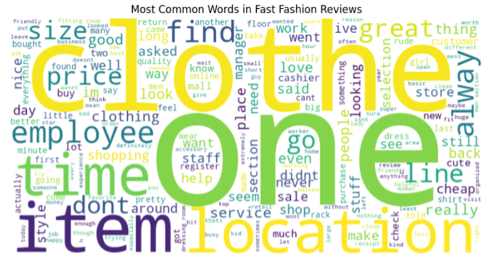
Reviews for Fast Fashion
Fast fashion shopping experiences are highly influenced by pricing, product variety, and customer service interactions, with both positive and negative sentiments shaping customer perceptions.
Customer Service Matters – Words like ‘employee,’ ‘staff,’ and ‘cashier’ highlight the impact of store interactions on the customer experience.
Price & Product Variety Are Key – Customers frequently mention ‘price,’ ‘cheap,’ ‘quality,’ and ‘selection,’ highlighting affordability as a key factor, but also express concerns about quality and stock availability.
Shopping Experience Is Crucial – Terms like location, store, section, mall suggest store layout and accessibility impact satisfaction.
Online vs. In-Store Comparison – Mentions of ‘online,’ ‘selection,’ and ‘store’ suggest that customers frequently compare their online and offline shopping experiences.
Mixed Customer Sentiment –
Positive: Great, nice, love, favorite → Customers appreciate affordability & variety.
Negative: Dont, still, return, asked → Issues with service, product availability, or returns.

Slide 12
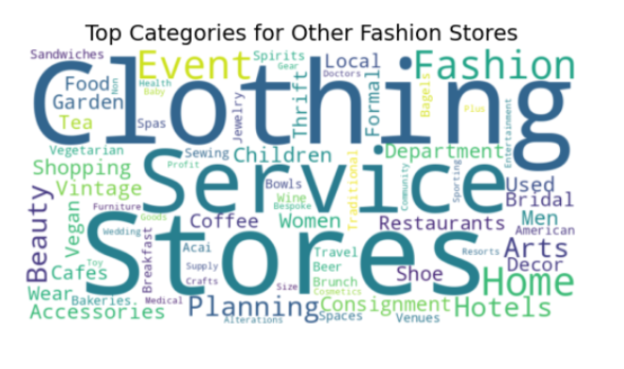
Reviews for Other Fashion
Other Fashion Stores prioritize customization, experiences, and sustainability, offering a broader retail approach beyond just clothing.
Fashion & Retail Focus – Includes clothing, shoes, accessories, thrift, and consignment, highlighting a mix of new, vintage, and second-hand fashion.
Service-Oriented – Words like planning, alterations, tailoring, bespoke show a focus on customization and personalized experiences.
Lifestyle & Sustainability – Mentions of home, hotels, cafes, events, vegan, and thrift indicate a blend of fashion with lifestyle, hospitality, and eco-conscious shopping.

Slide 13

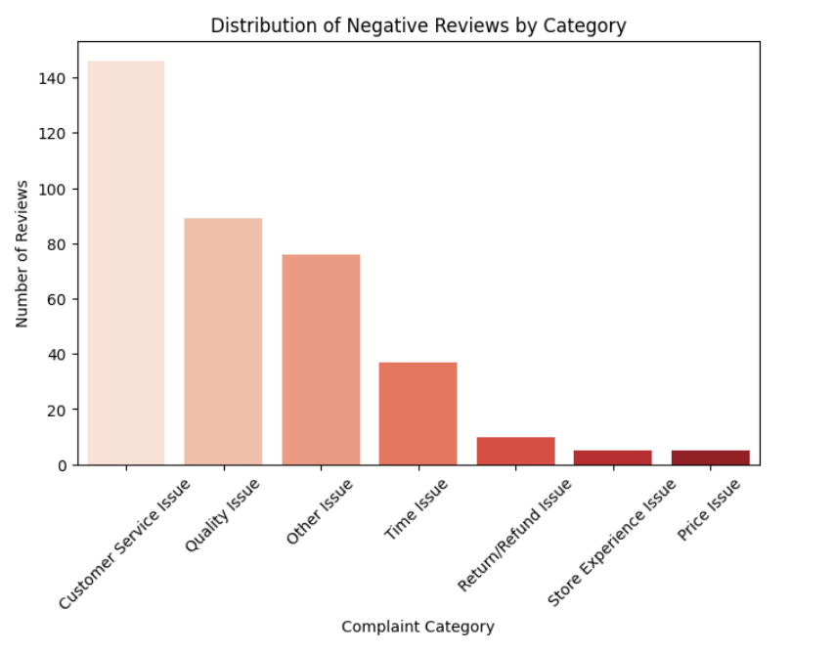
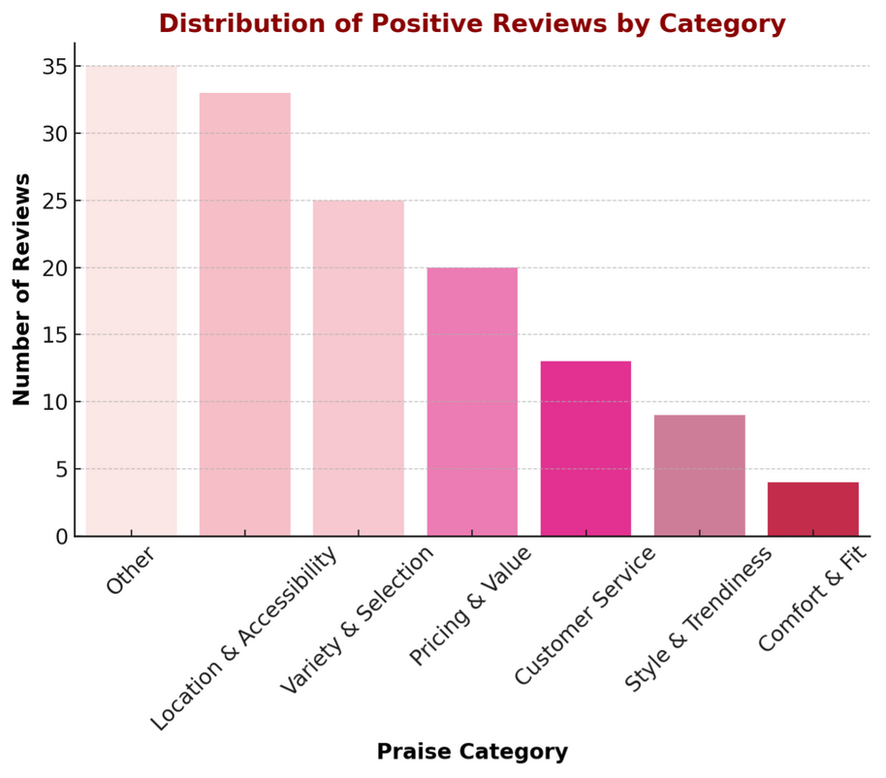

POSITIVE AND NEGATIVE REVIEWS BY CATEGORY
Label specific words
Ex. Quality-related issues:{ 'cheap,' 'thin,' 'broken,' 'poor,' 'material,' 'quality.'}

Slide 14


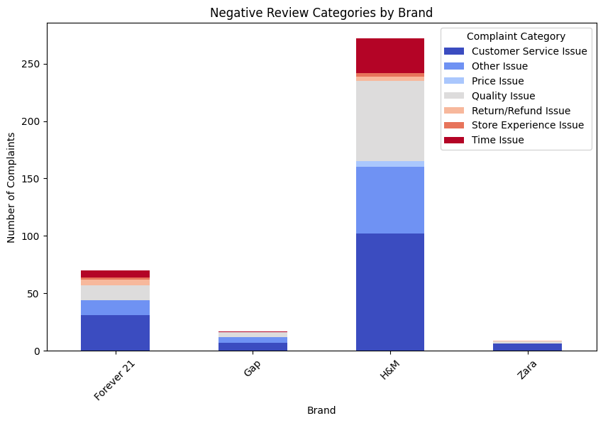
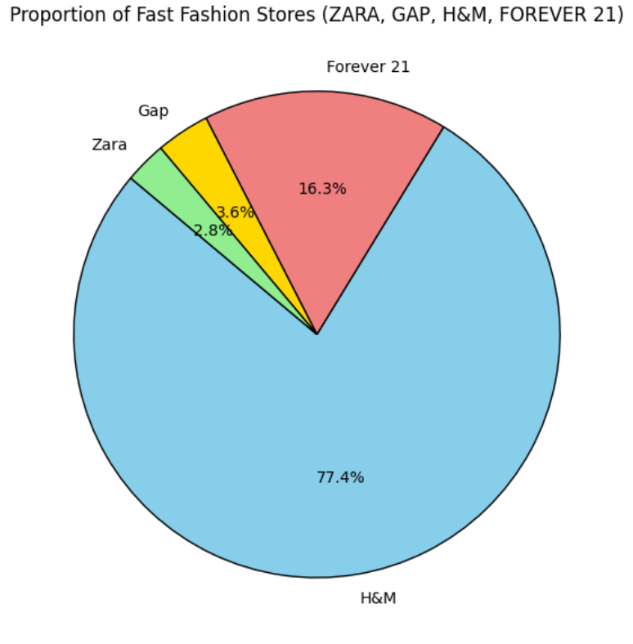
Fast Fashion’s Negative Reviews Proportion

Slide 15
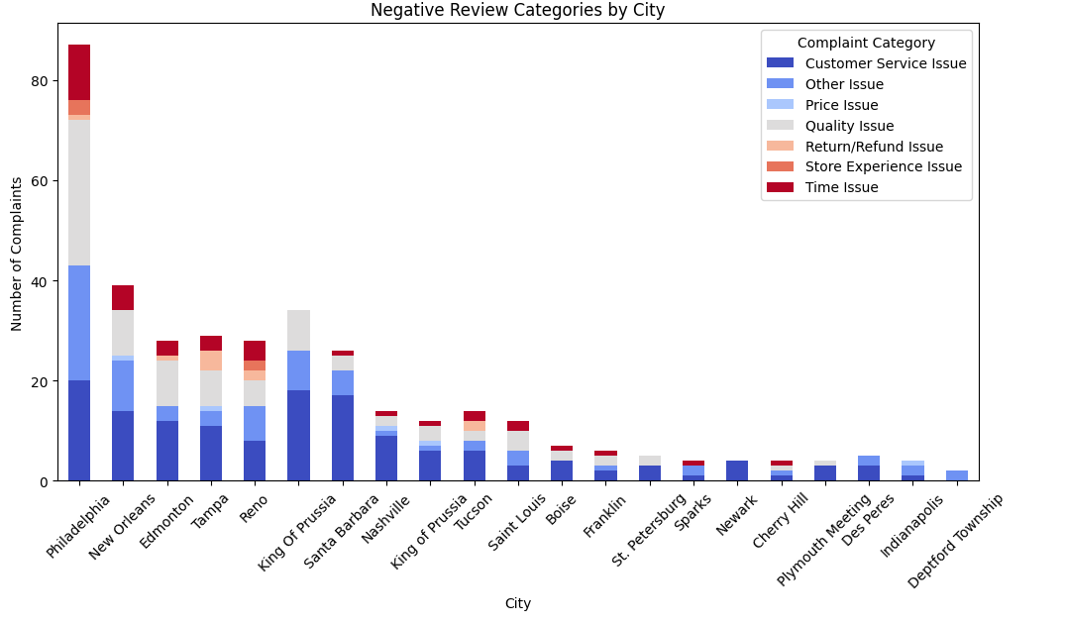

Slide 16
Key Findings : Using BERT
Pipeline Steps in Function: Raw text to Structured meaningful input
Lowercasing → Standardizes text for uniformity.
Removing Special Characters → Keeps only alphabets.
Tokenization → Splits text into individual words.
Stopword Removal & Lemmatization → Keeps meaningful words and converts them to base form.
Rejoins Words → Prepares the text for modeling.

Slide 17
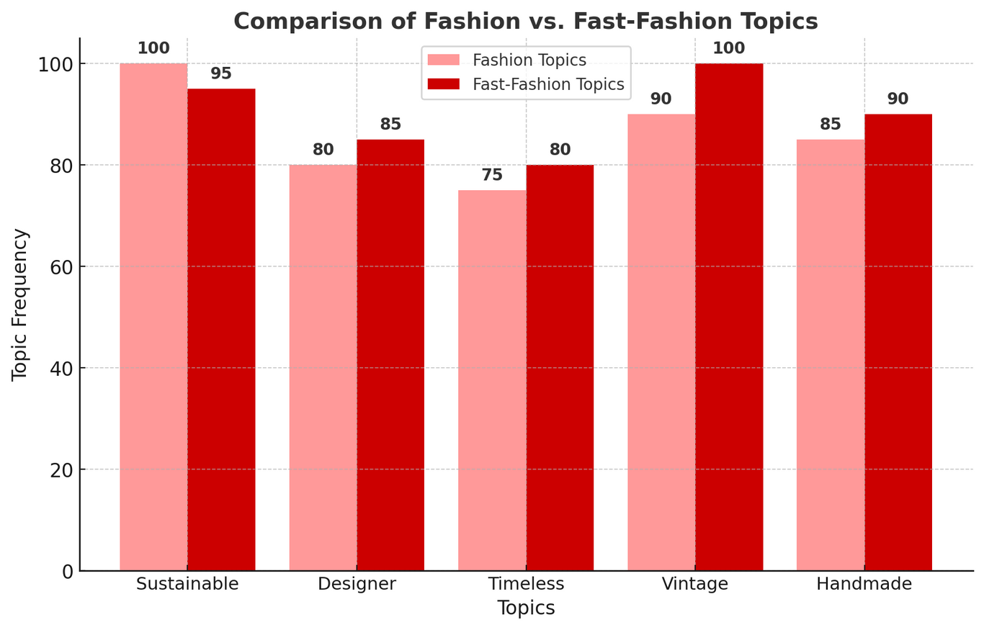
Comparing Fashion vs. Fast-Fashion Discussions
The slight variations in topic frequency between fashion vs. fast fashion are reasonable, as fast fashion brands market themselves using timeless and sustainable themes, even if they don’t always adhere to them.
The Designer topic is slightly higher in fast fashion (85% vs. 80%) because many fast fashion brands replicate high-end designs.
Sustainability is more dominant in the Fashion dataset, while mass production and discounts are more prevalent in Fast-Fashion.

Slide 18
Insights and Business Applications
How Can Businesses Use This Data?
For Brands:
Luxury brands should market sustainability and craftsmanship.
Fast-fashion brands should improve quality perceptions.
For Researchers:
Helps track evolving trends or the marketing trends in the fashion industry.

Slide 19


